Slide 1
Sprint #0
[Hip, Hip]

Slide 2
Over the Next 10-15 Minutes We Will…
Go over team basics
Our roles, selected project, and the tools that we will be using
Show off the user stories
Present our prototype GUI

Slide 3
Team [Hip, Hip] Overview
Team Name: [Hip, Hip]
Chosen Project: Insurance Claims System
Serving as Scrum Master: Davis Botta
Alea Alvi and Jack Parcell on Back-End
Elizabeth Dixon and Davis Botta on Front-End

Slide 4
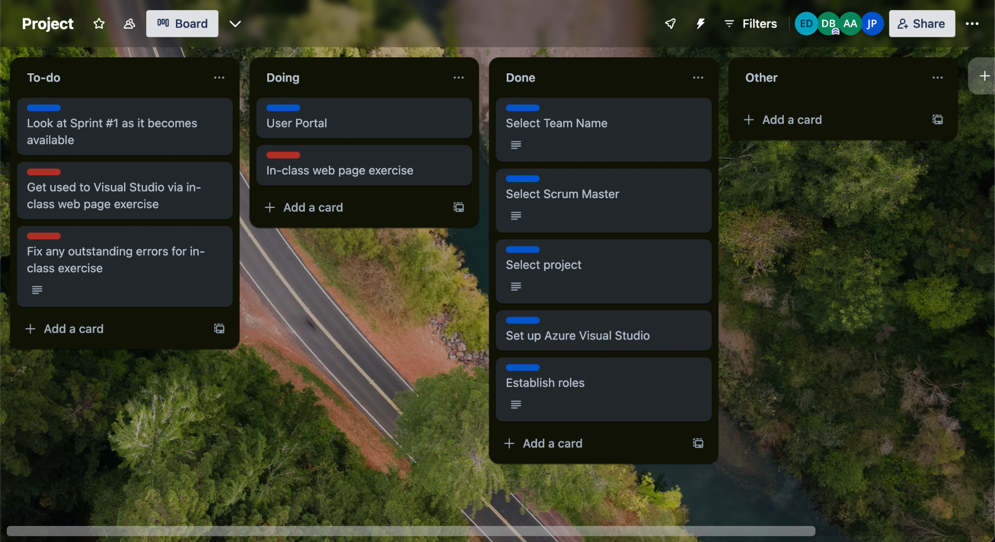
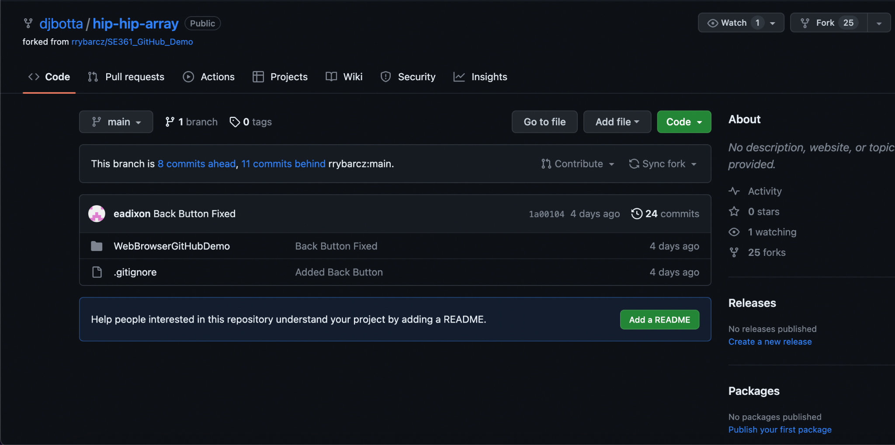
Trust the Process
We will be using a trello board for project tracking
Can collaborate and see ideas for the project as they come up
We have successfully created and used a GitHub repository
Can clone into Visual Studio, but need to work out commits, merges, etc. logistics

Slide 5
A Sample of User Stories
As an admin, I want to be able to log into the ICMS to perform my admin duties
As an admin, I want to be able to view all user details so that I can perform my admin duties
As a client, I want to be able to upload scanned documents so they are saved on the database
As a client, I want to be able to view and edit my profile to ensure that it has the most up to date information
As a CM, I want to be able to view the profile of a particular client so that I can see information regarding only them
As a CM, I want to be able to validate and transfer files to the finance manager so that they can send clients checks
As a FM, I want to be able to view and edit my profile so that it has the most up to date information
As a FM, I want to be able to view the profile of a particular client so I can calculate their risk

Slide 6
Rough GUI Front-end Design
We have created an HTML prototype

